Slide 2
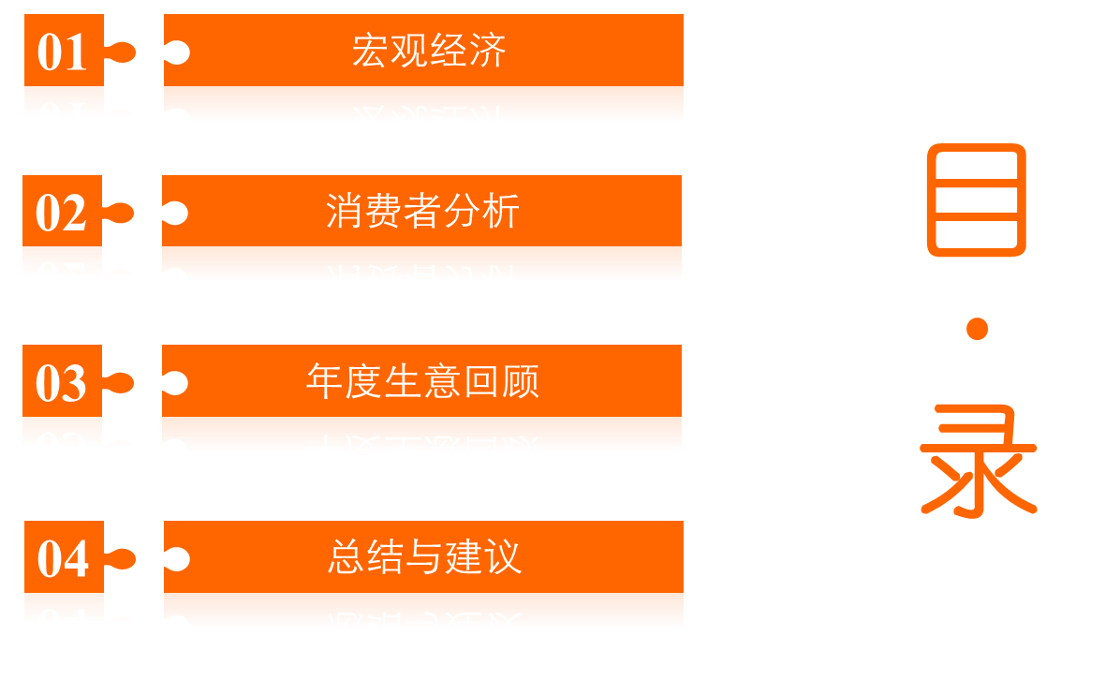

Slide 3


Slide 4
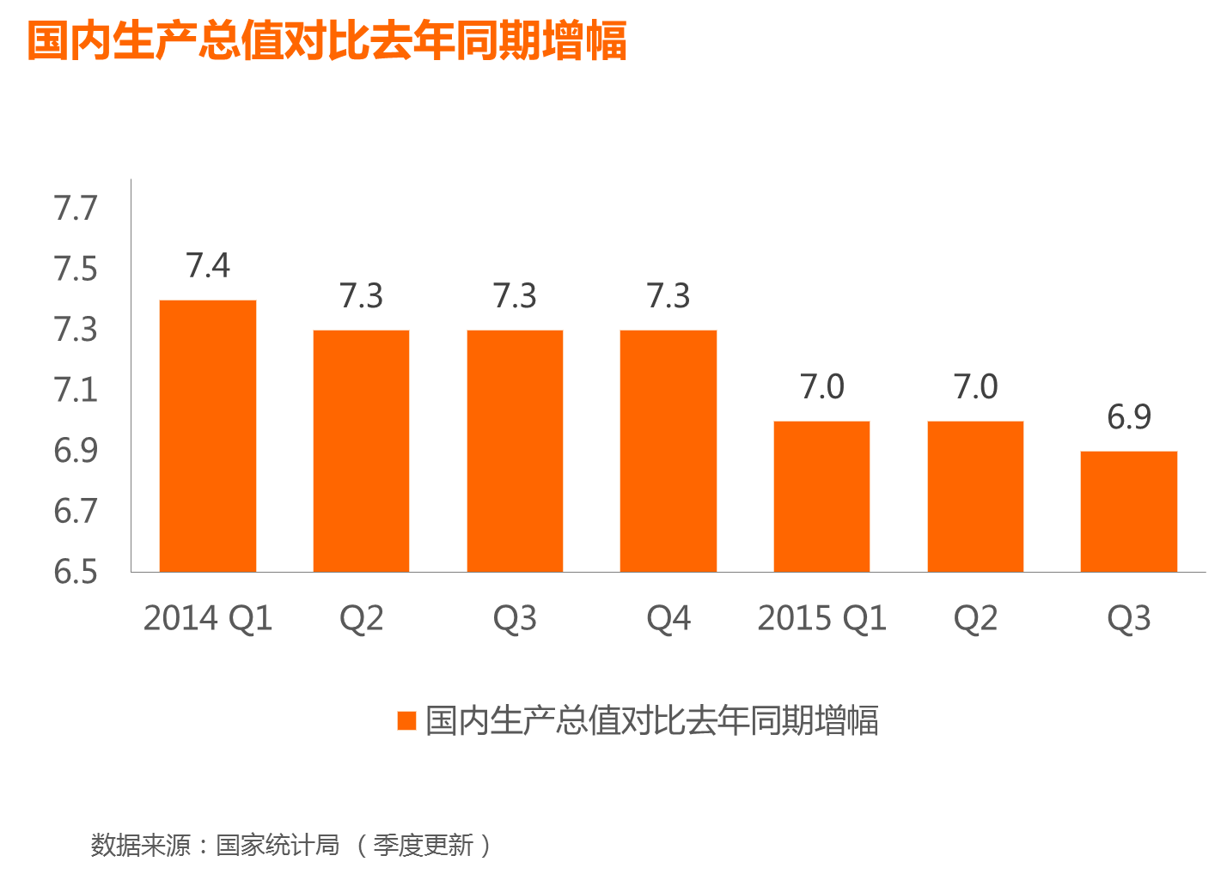
Notes:
4

Slide 5
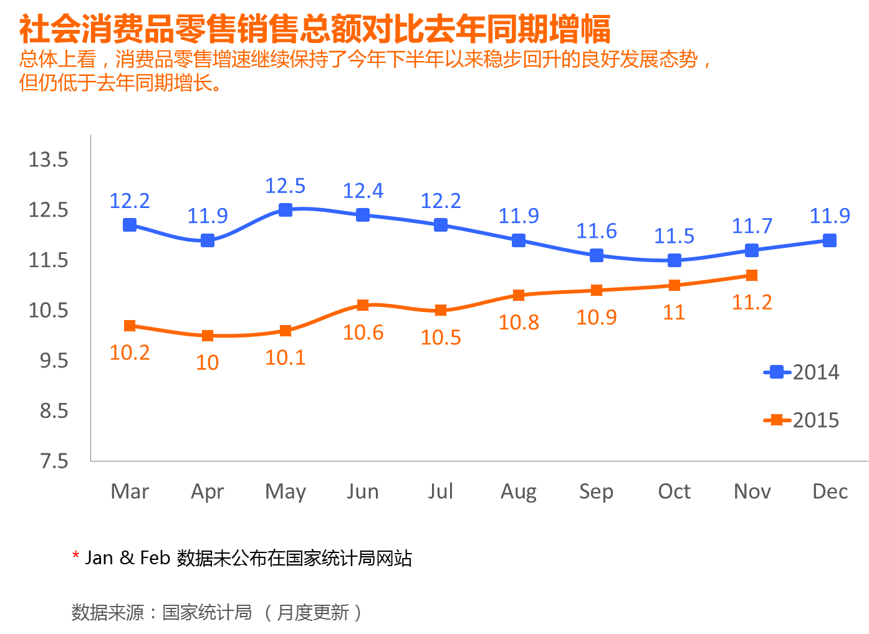

Slide 6
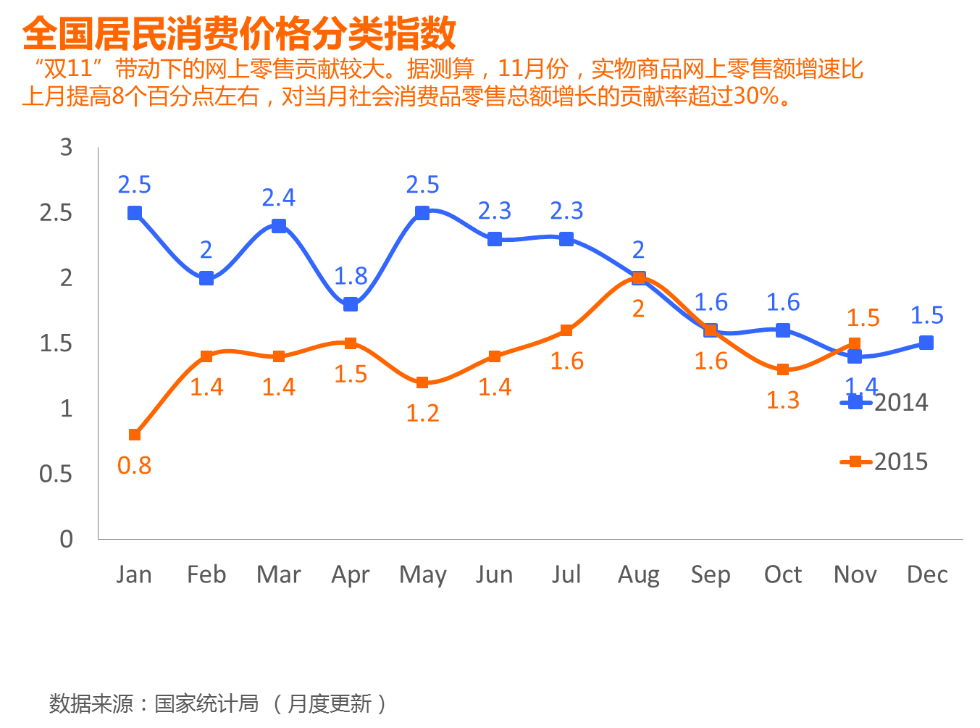

Slide 7
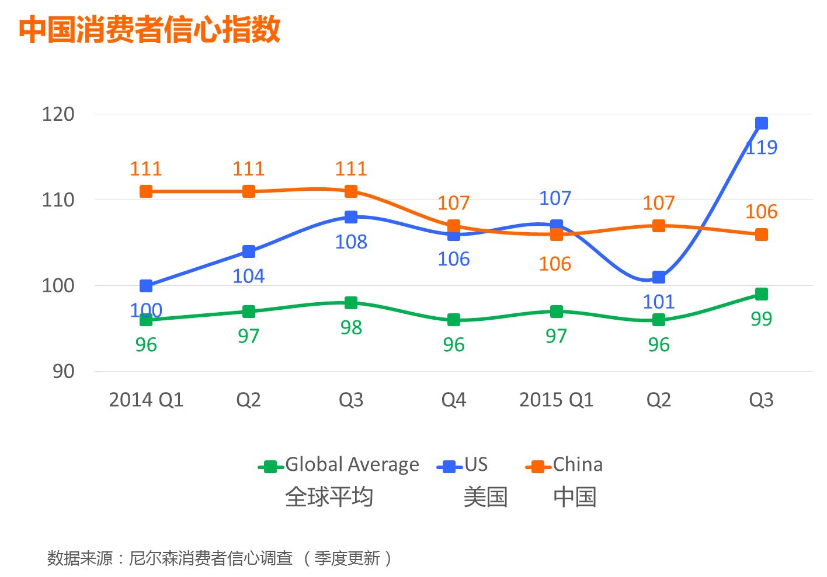

Slide 8
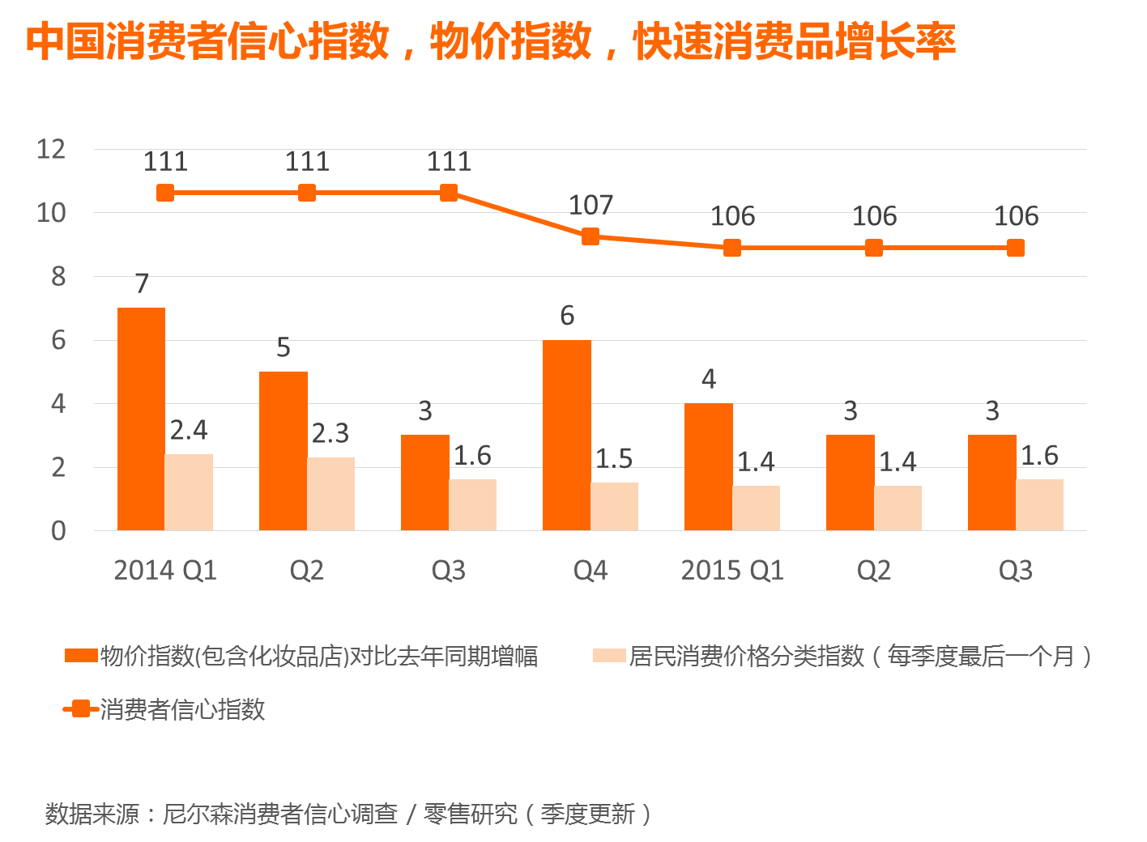

Slide 9
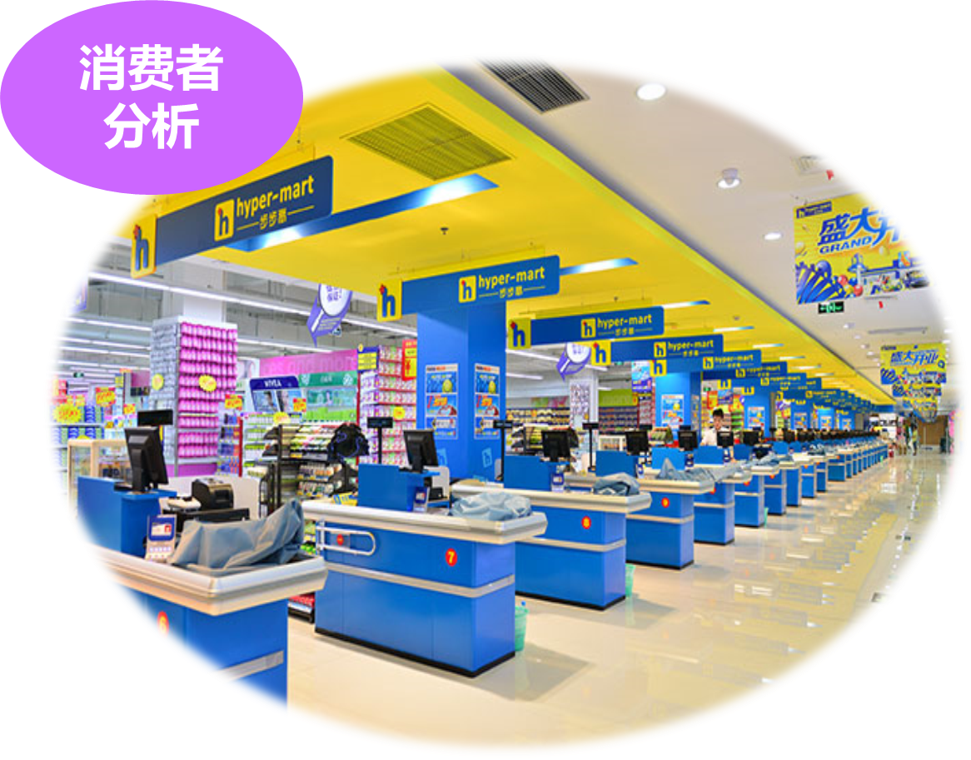

Slide 10
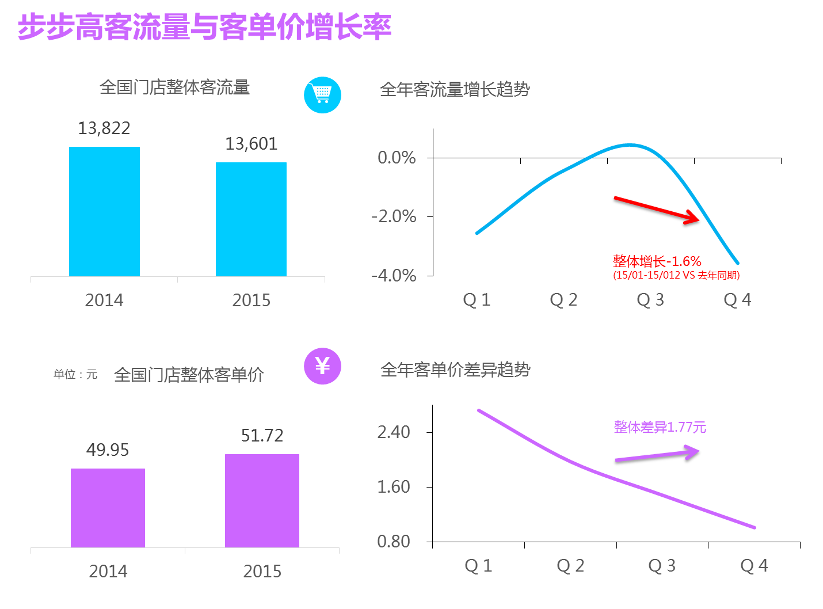

Slide 11
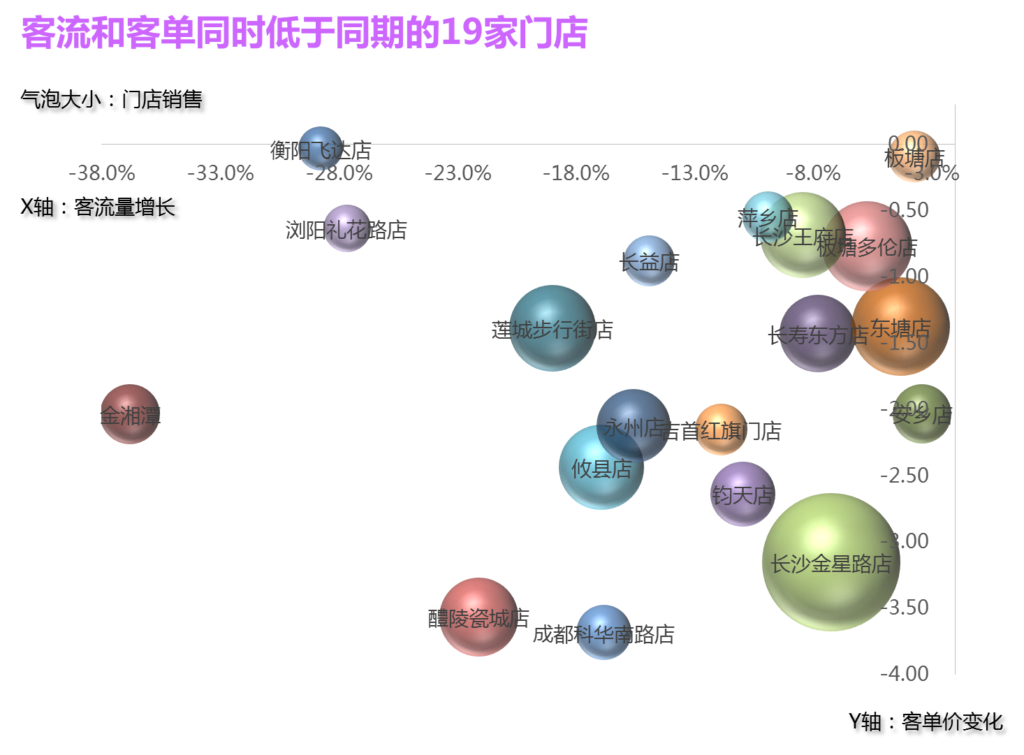

Slide 12
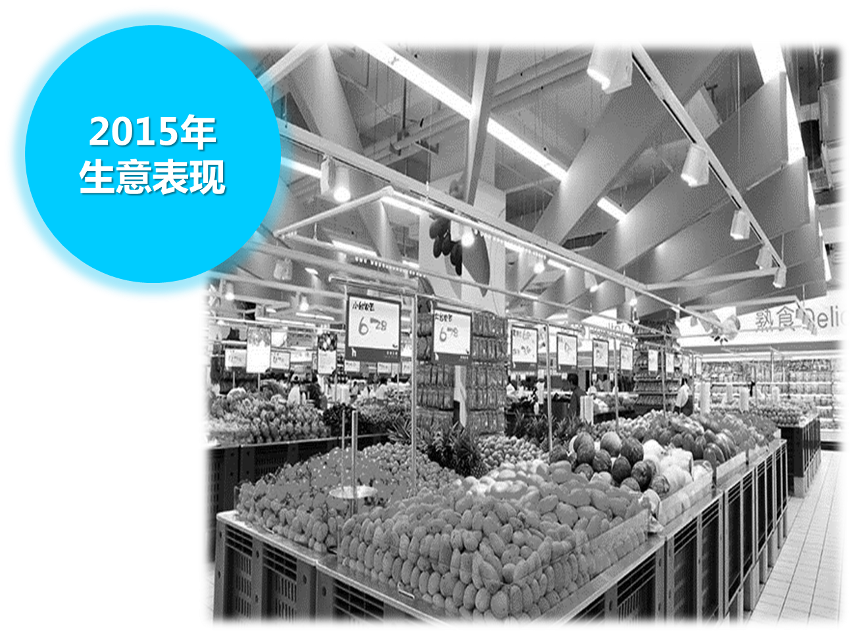

Slide 13


Slide 14
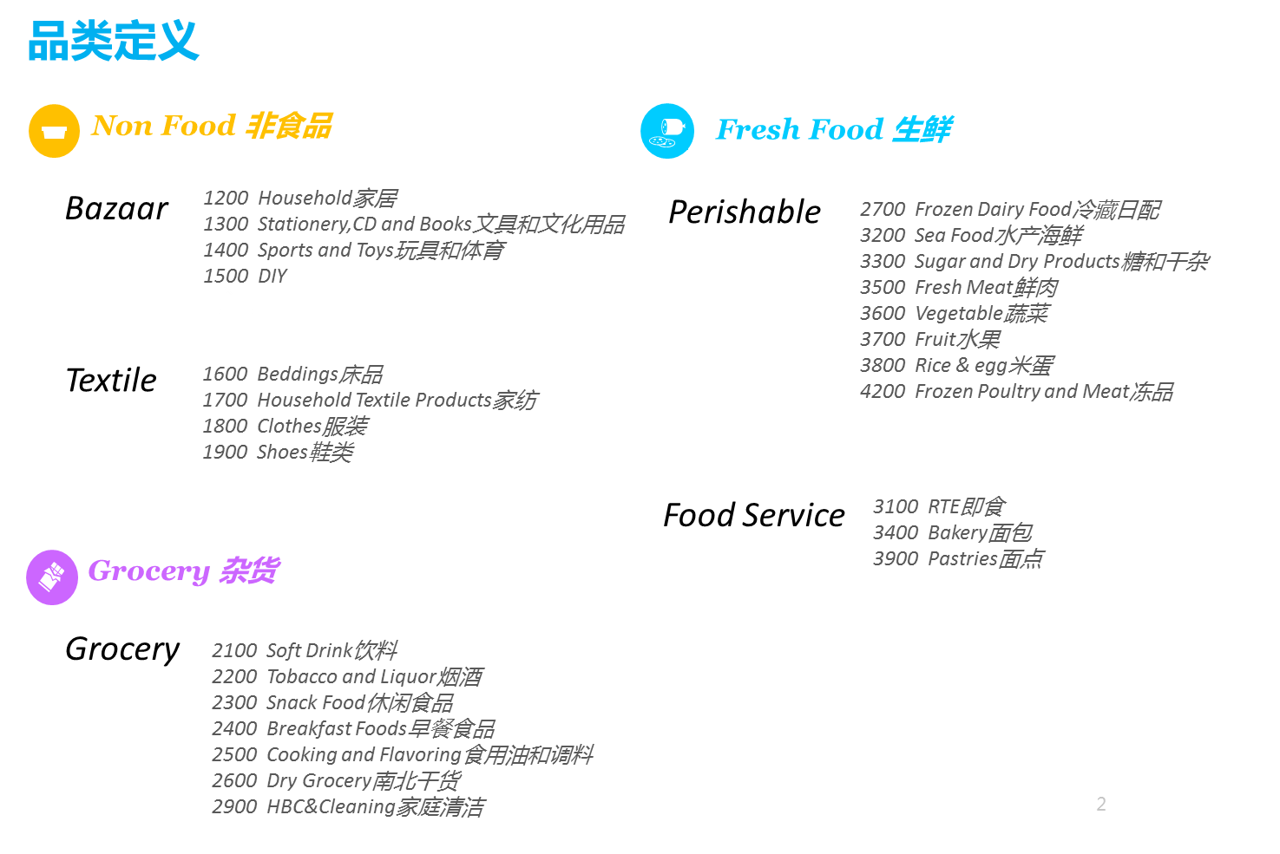

Slide 15
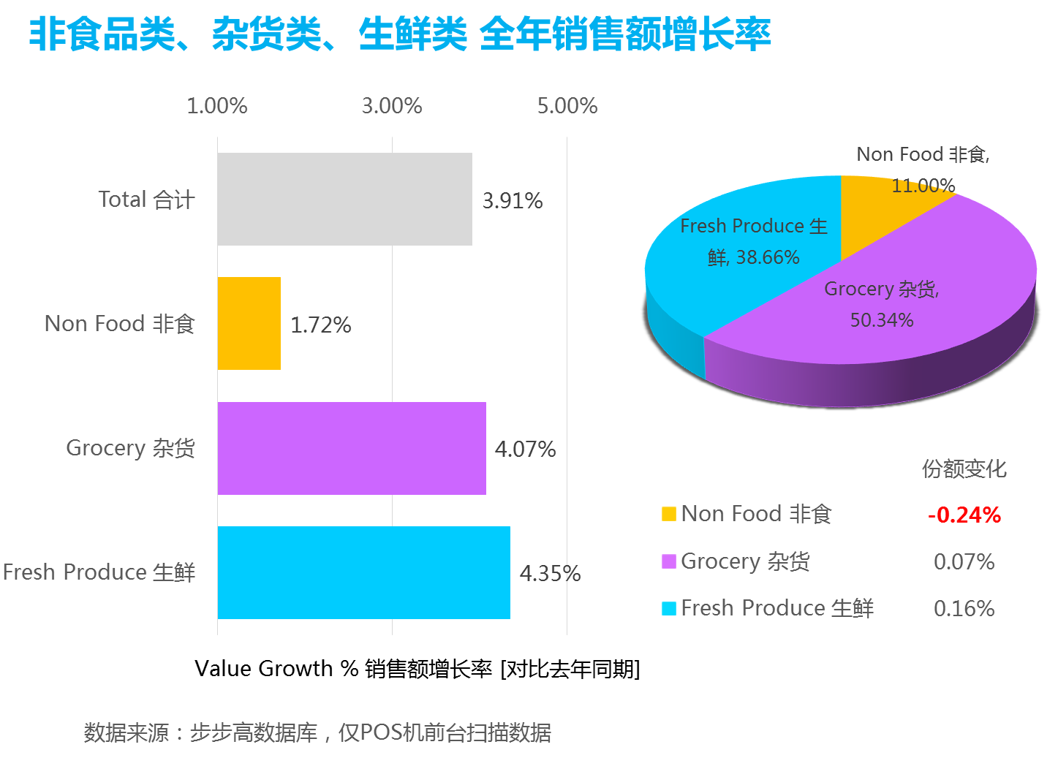

Slide 16
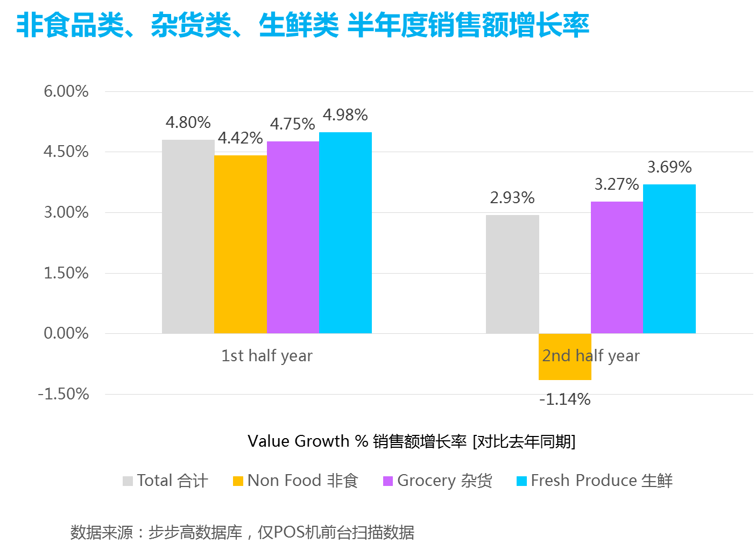

Slide 17
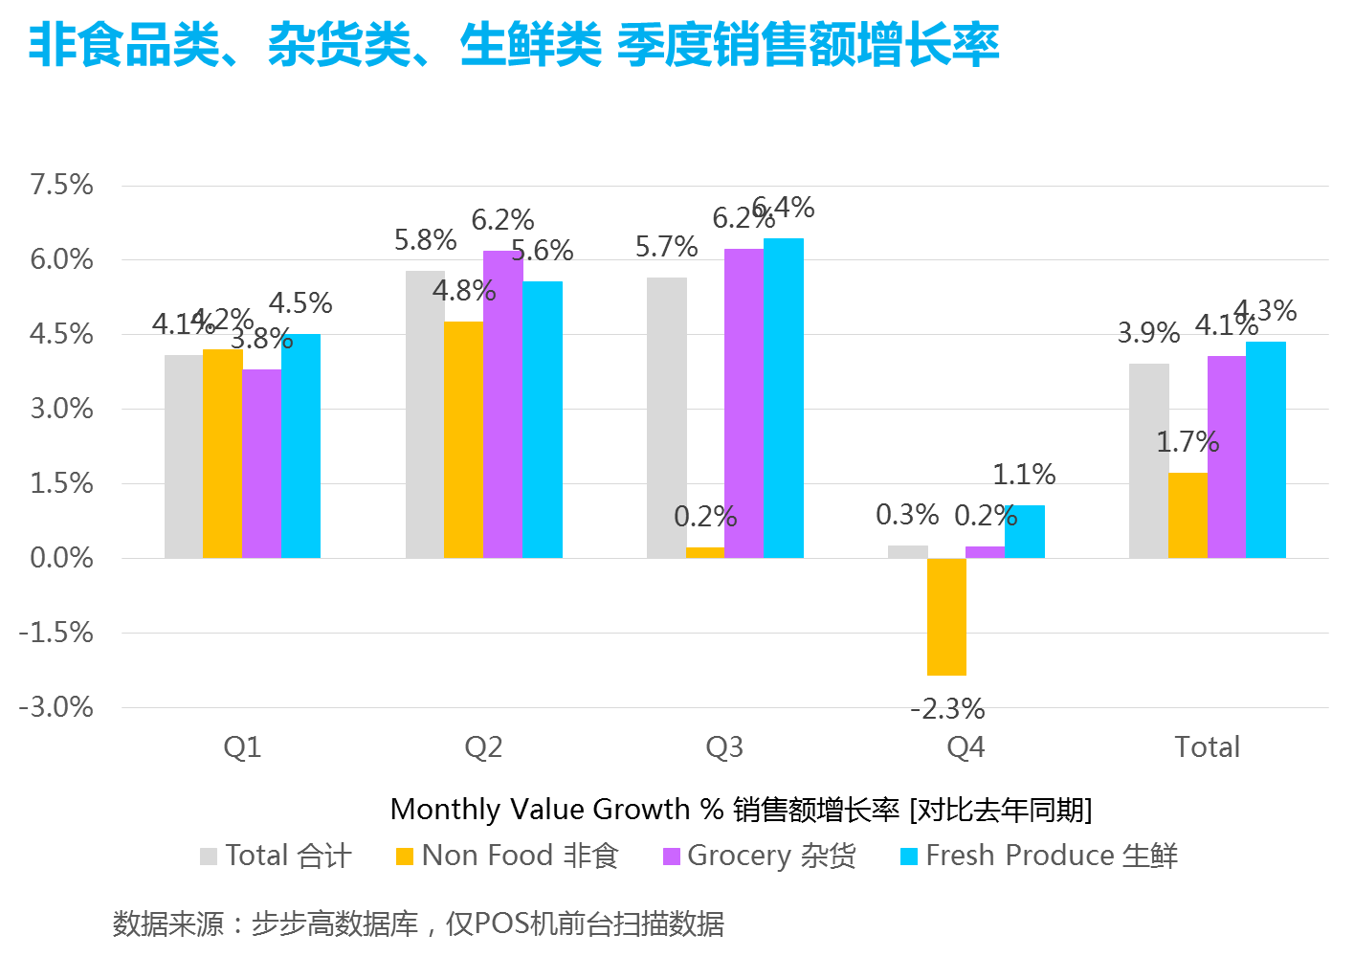

Slide 18
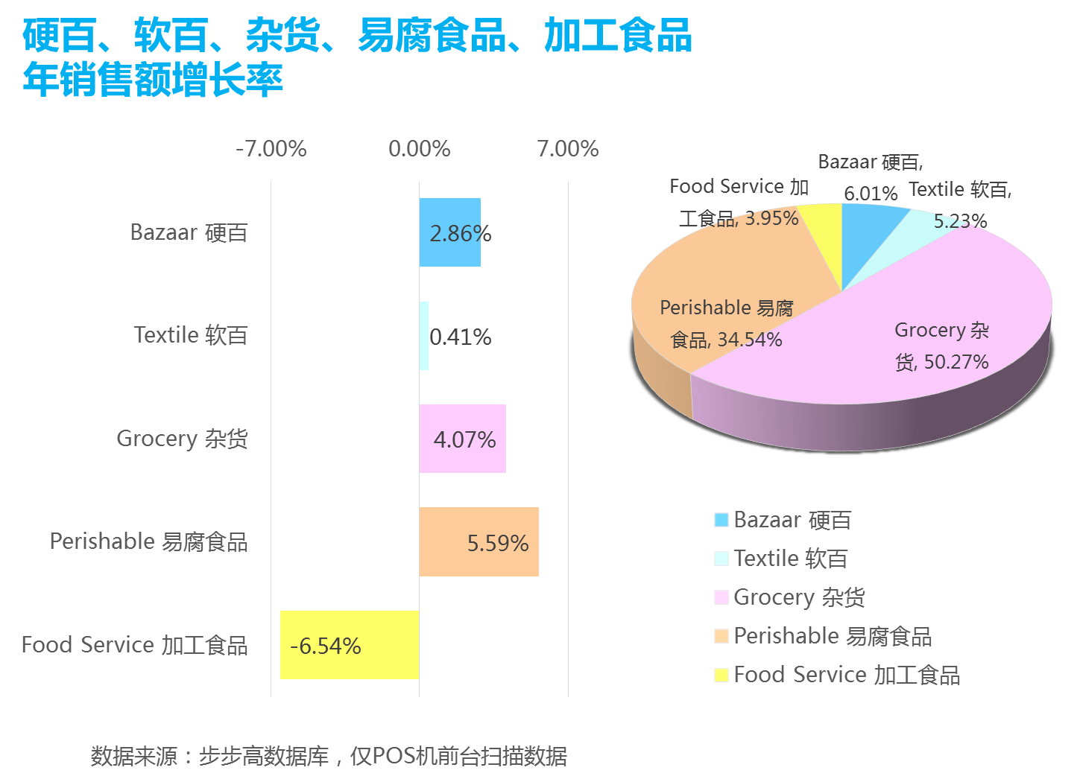

Slide 19
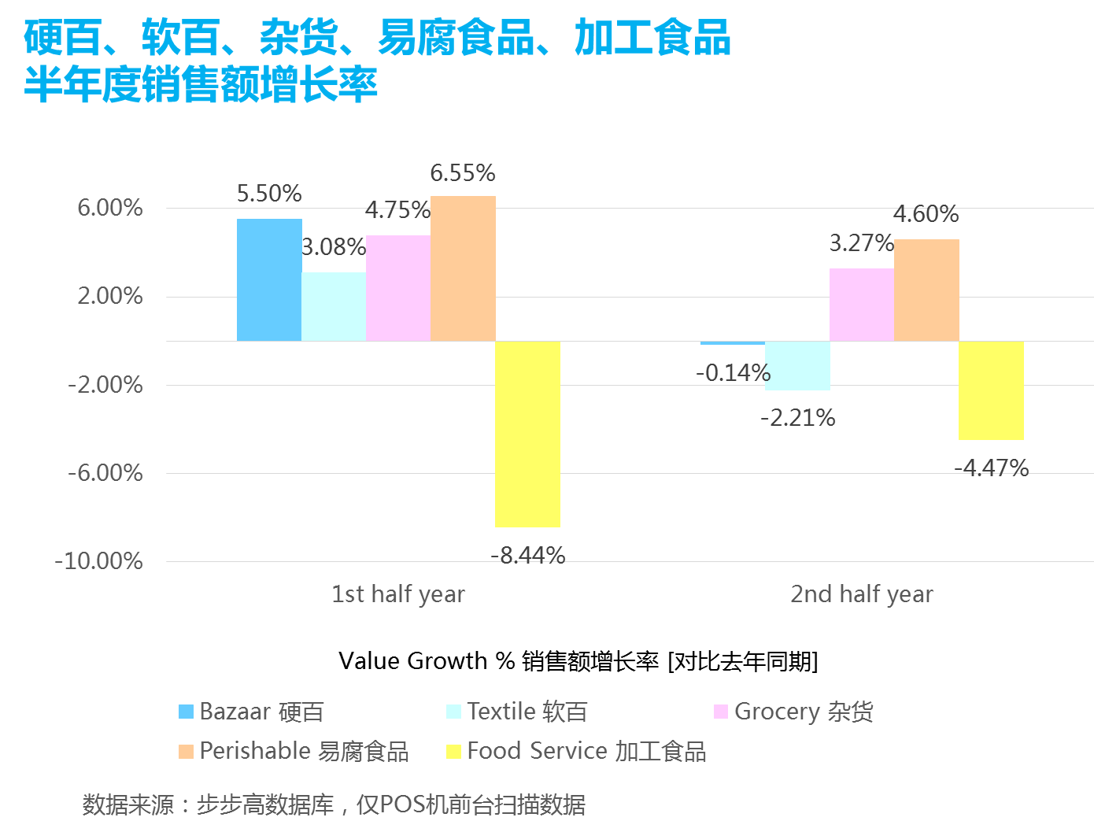

Slide 20
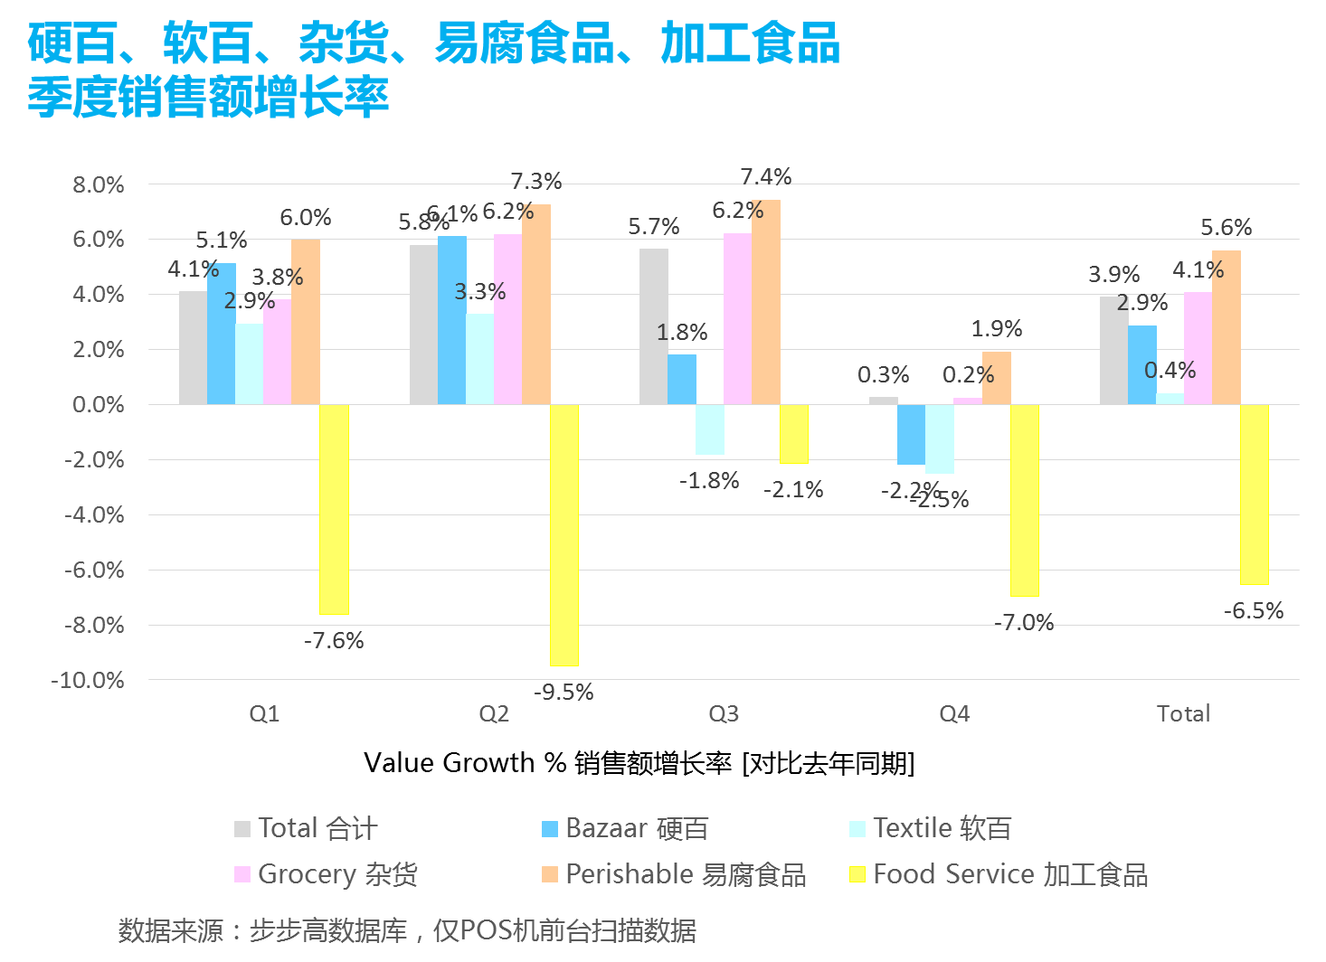

Slide 21
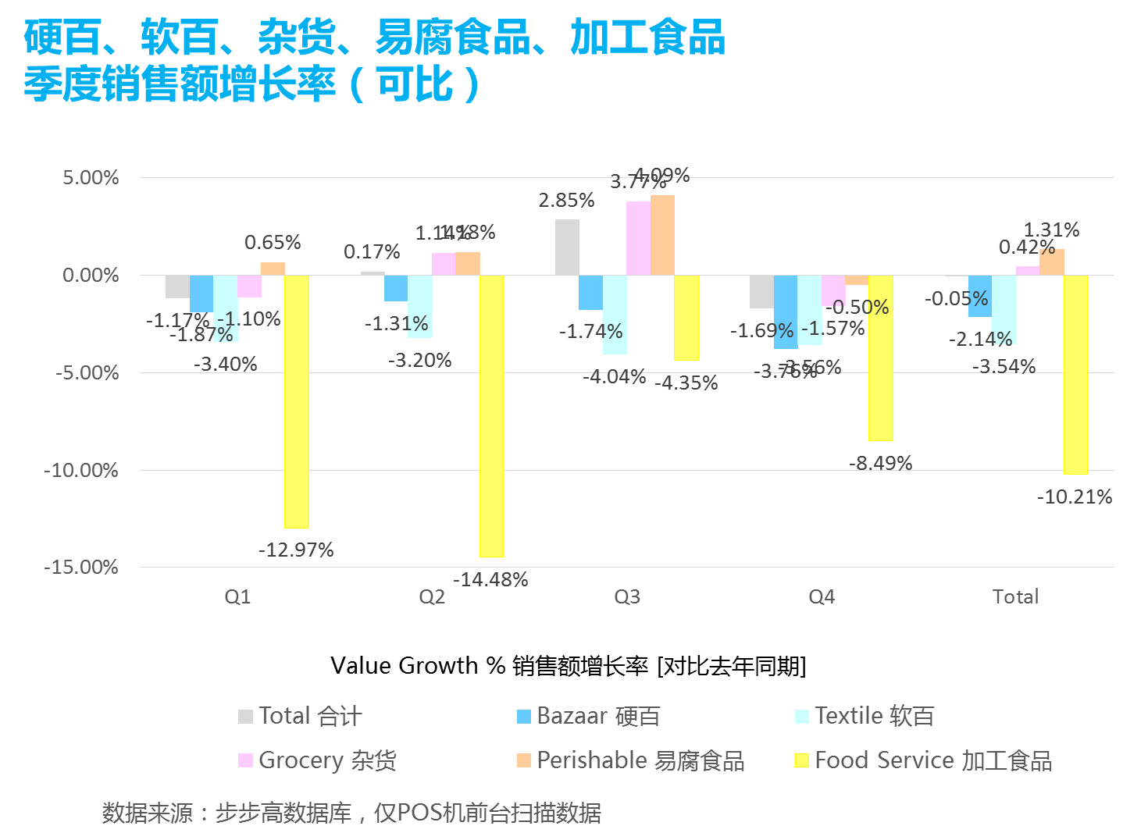

Slide 22
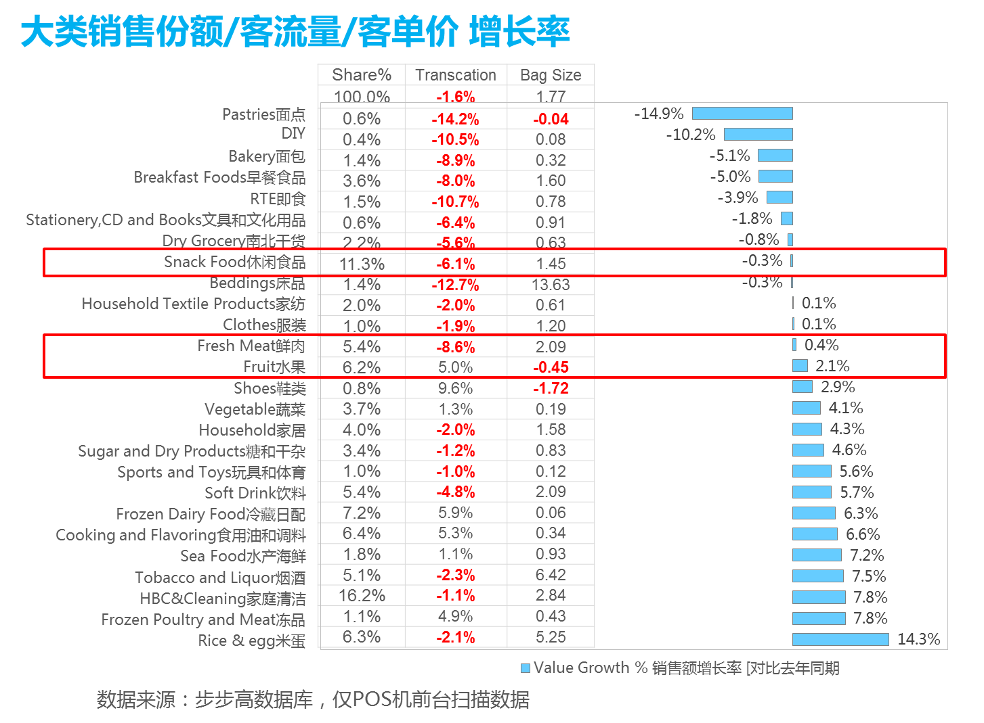

Slide 23
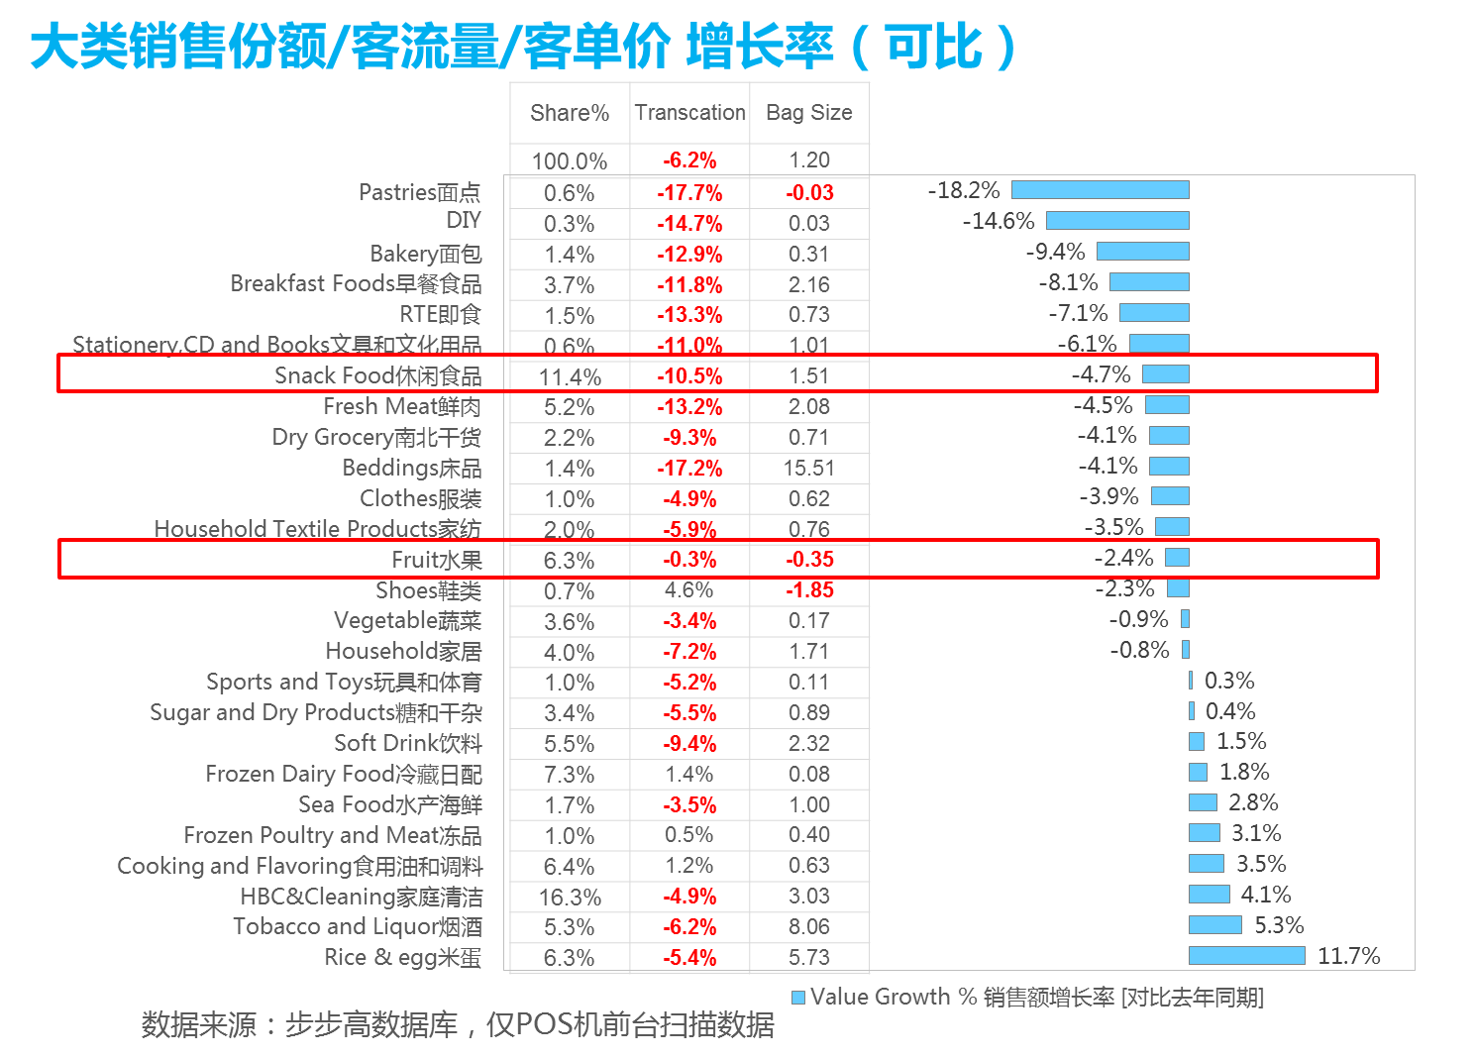

Slide 24
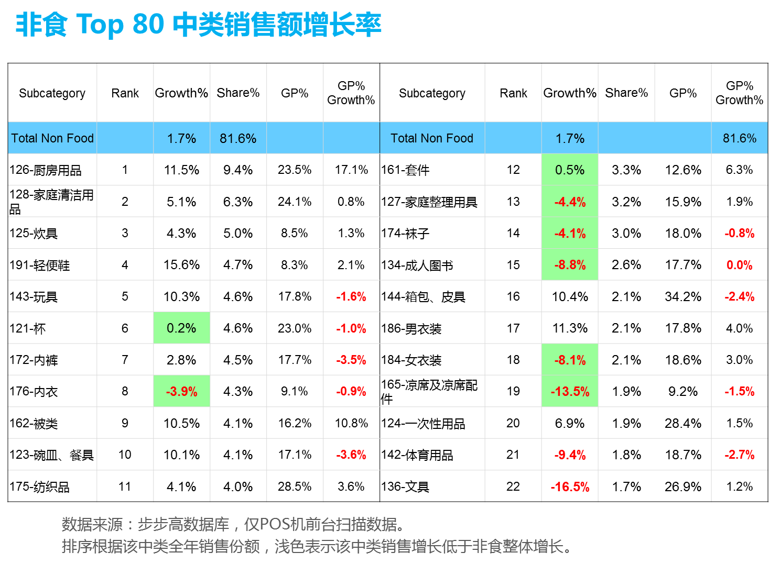

Slide 25
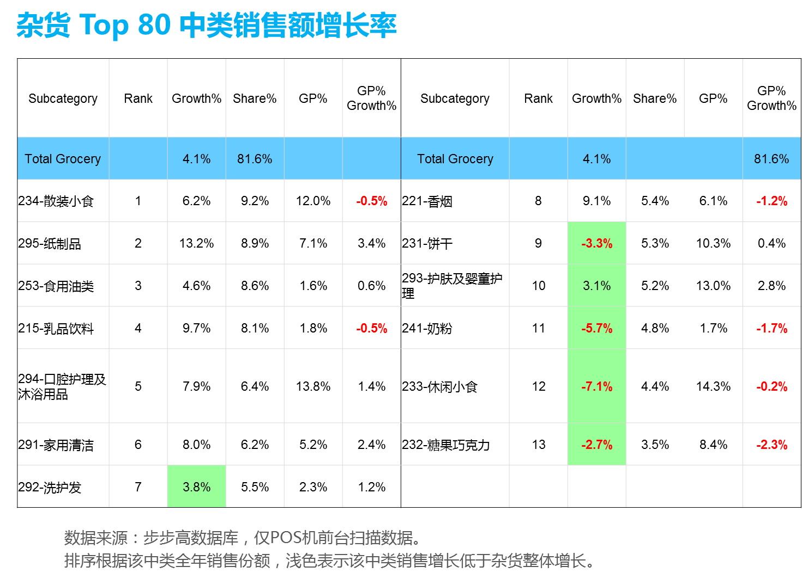

Slide 26
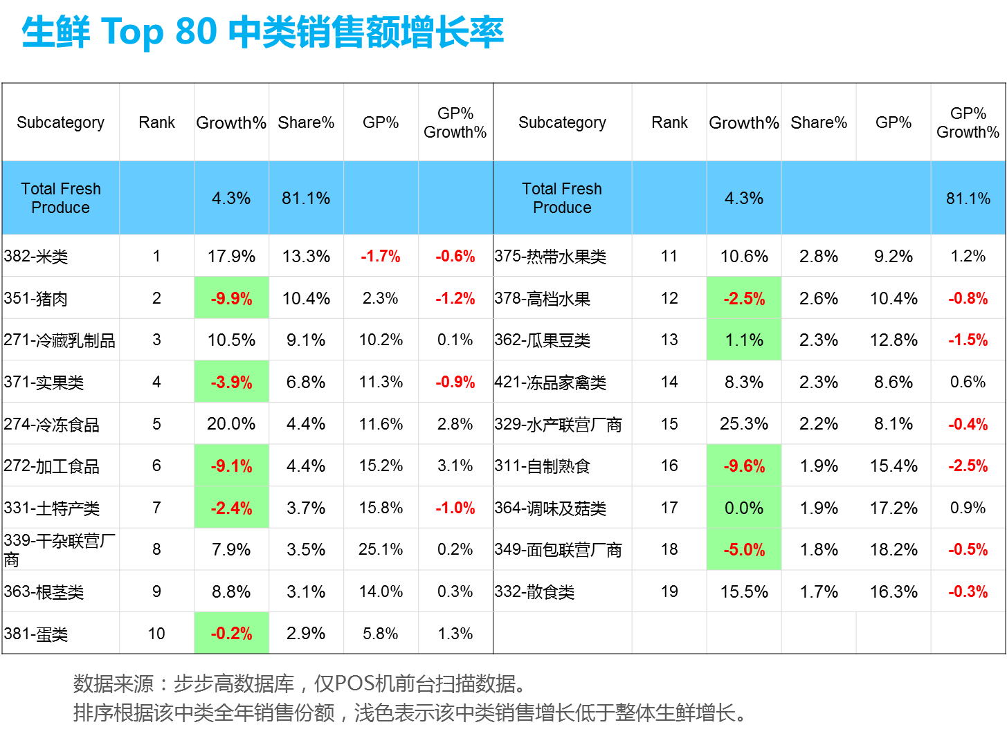

Slide 27
城市 品类 销售额增长率
 |  | Hunan | Jiangxi | Chongqing | Sichuan | Guangxi
 | Total 合计 | 3% | -3% | 77% | 32% | -3%
3800 | Rice & egg米蛋 | 13% | 5% | 152% | 26% | 7%
4200 | Frozen Poultry and Meat冻品 | 4% | -1% | 140% | 37% | 10%
2900 | HBC&Cleaning家庭清洁 | 7% | 1% | 91% | 38% | -5%
2200 | Tobacco and Liquor烟酒 | 5% | 27% | 49% | 67% | -4%
3200 | Sea Food水产海鲜 | 7% | -8% | 95% | 10% | -14%
2500 | Cooking and Flavoring食用油和调料 | 6% | -2% | 99% | 28% | 3%
2700 | Frozen Dairy Food冷藏日配 | 5% | 5% | 63% | 37% | 0%
2100 | Soft Drink饮料 | 6% | -11% | 85% | 55% | -10%
1400 | Sports and Toys玩具和体育 | 4% | 2% | 56% | 50% | -12%
3300 | Sugar and Dry Products糖和干杂 | 3% | -4% | 92% | 33% | 9%
1200 | Household家居 | 4% | -2% | 48% | 41% | -4%
3600 | Vegetable蔬菜 | 1% | -2% | 75% | 36% | -1%
1900 | Shoes鞋类 | 2% | -1% | 41% | 23% | -41%
3700 | Fruit水果 | 1% | -11% | 58% | 51% | 18%
3500 | Fresh Meat鲜肉 | -2% | -6% | 80% | 4% | 11%
1800 | Clothes服装 | -2% | 9% | 30% | 44% | 73%
1700 | Household Textile Products家纺 | 0% | -16% | 73% | 29% | -14%
1600 | Beddings床品 | -1% | -3% | 48% | 23% | -23%
2300 | Snack Food休闲食品 | -1% | -3% | 74% | 36% | -11%
2600 | Dry Grocery南北干货 | -1% | -12% | 86% | 23% | -6%
1300 | Stationery,CD and Books文具和文化用品 | -3% | 3% | 38% | 23% | -7%
3100 | RTE即食 | -5% | 4% | 35% | -7% | -10%
2400 | Breakfast Foods早餐食品 | -5% | -19% | 43% | 42% | 4%
3400 | Bakery面包 | -6% | -12% | 67% | 30% | -13%
1500 | DIY | -12% | -1% | 32% | 19% | -17%
3900 | Pastries面点 | -15% | -19% | 19% | -14% | -30%
数据来源：步步高数据库，仅POS机前台扫描数据。排序根据整体增长。

Slide 28
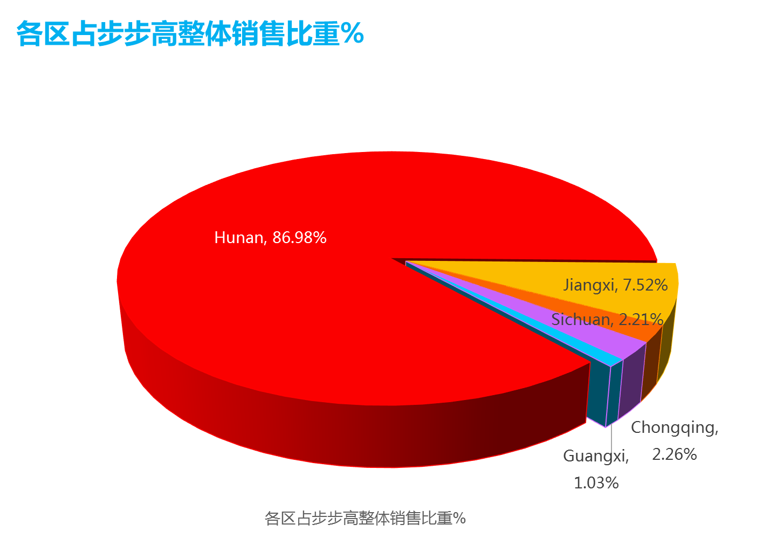
省份 | 占比 | 增长
Hunan | 86.98% | 2.9%
Jiangxi | 7.52% | -2.8%
Sichuan | 2.21% | 31.9%
Chongqing | 2.26% | 77.3%
Guangxi | 1.03% | -3.1%
总计 | 100.00% | 3.9%

Slide 29
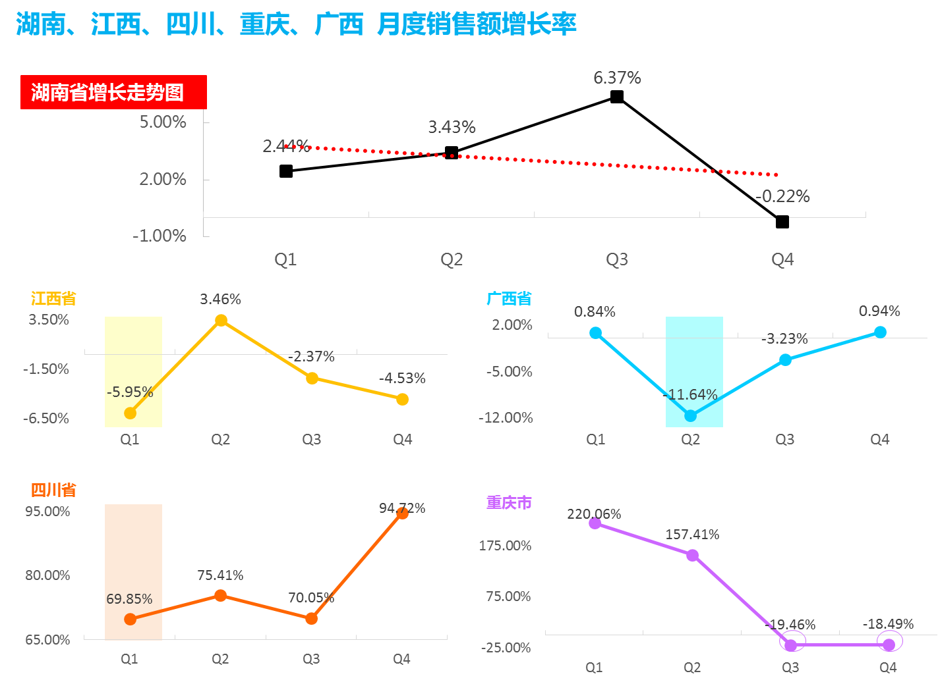

Slide 30


Slide 31
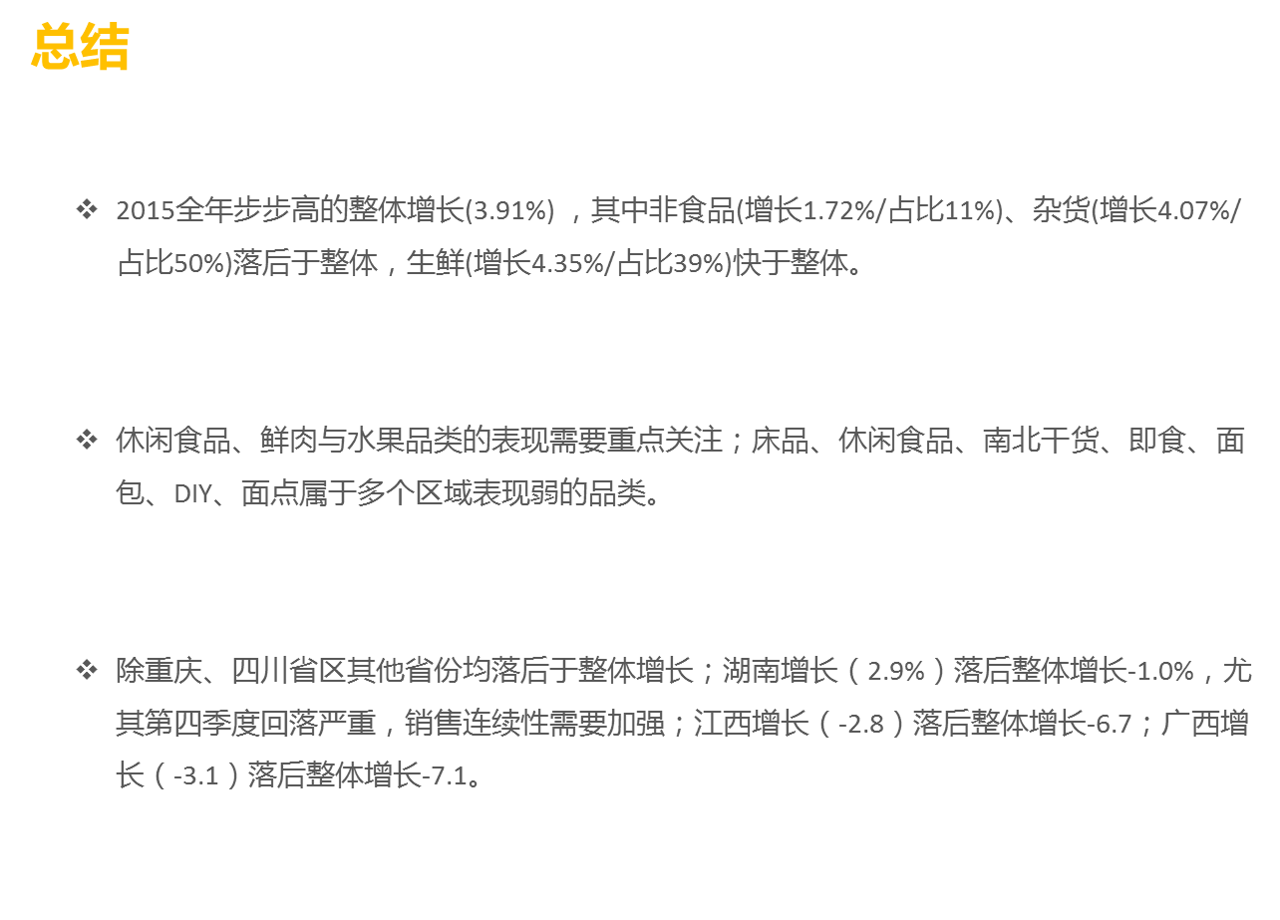

Slide 32


